Slide 1
Global Warming
What is Climate Change?
The global climate is the connected system of sun, earth and oceans, wind, rain and snow, forests, deserts and savannas, and everything people do, too. The climate of a place, say New York, can be described as its rainfall, changing temperatures during the year and so on.

Slide 2
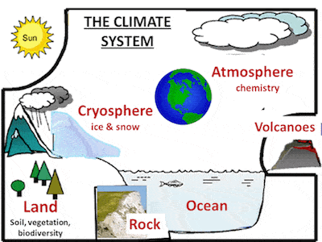
Climate System
A description of the global climate includes how, for
example, the rising temperature of the Pacific feeds
typhoons which blow harder, drop more rain and cause
more damage, but also shifts global ocean currents that melt
Antarctica ice which slowly makes sea level rise until New
York will be under water.
It is this systemic connectedness that makes global climate
change so important and so complicated.

Slide 3
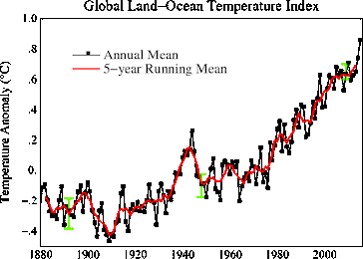
Module by NASA

Slide 4
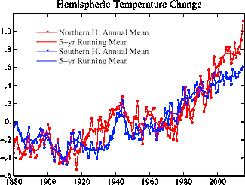

Slide 5
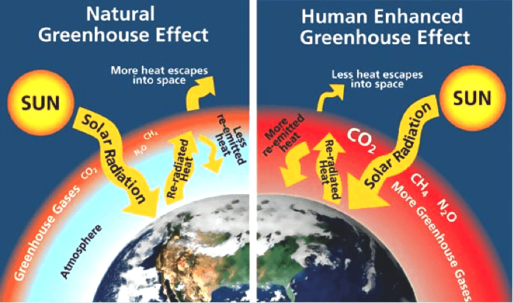
Greenhouse Effect

Slide 6
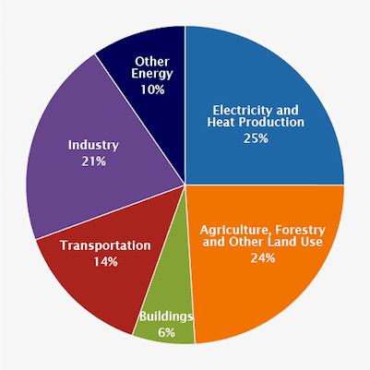
Global Emissions Sector 2015

Slide 7
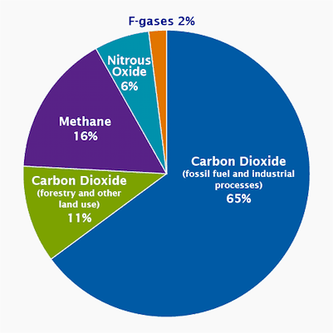
Global Emissions Gas 2015

